Slide 1
Unsupervised Learning

Slide 2

Agenda
Clustering
K-Means
Cost
Initialization
Anomaly Detection
Jupyter Notebook
Jupyter Notebook

Slide 3
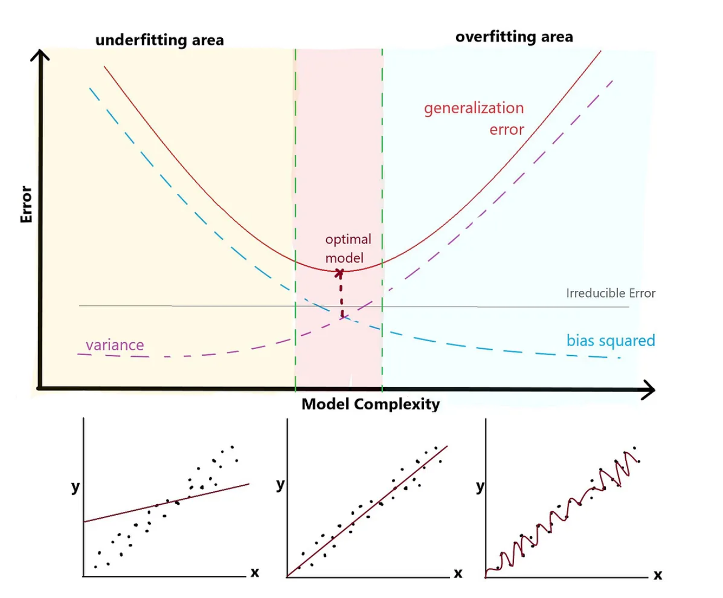
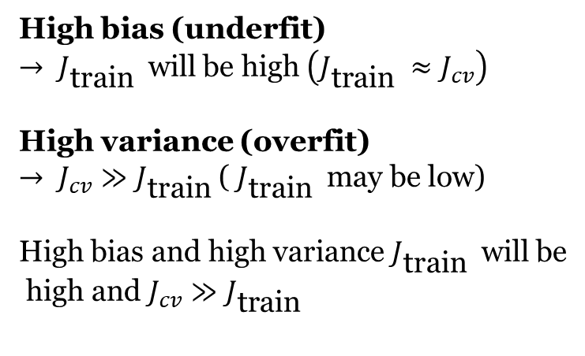
RECAP
High bias (underfit)
$→ J_{\text{train} }$ will be high $\left(J_{\text{train} }≈J_{cv}\right)$
High variance (overfit)
$→ J_{cv}≫J_{\text{train} }$( $J_{\text{train} }$ may be low)
High bias and high variance $J_{\text{train} }$ will be
high and $J_{cv}≫J_{\text{train} }$

Slide 4
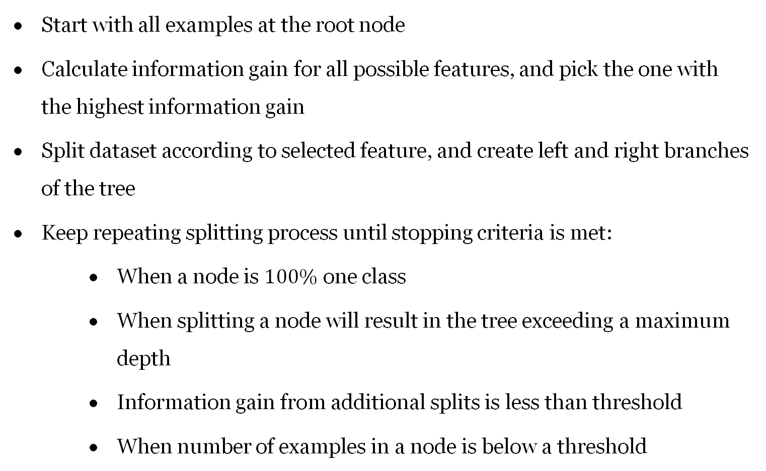
Decision Tree Learning
RECAP
Start with all examples at the root node
Calculate information gain for all possible features, and pick the one with the highest information gain
Split dataset according to selected feature, and create left and right branches of the tree
Keep repeating splitting process until stopping criteria is met:
    When a node is $100\%$ one class
    When splitting a node will result in the tree exceeding a maximum depth
    Information gain from additional splits is less than threshold
    When number of examples in a node is below a threshold

Slide 5
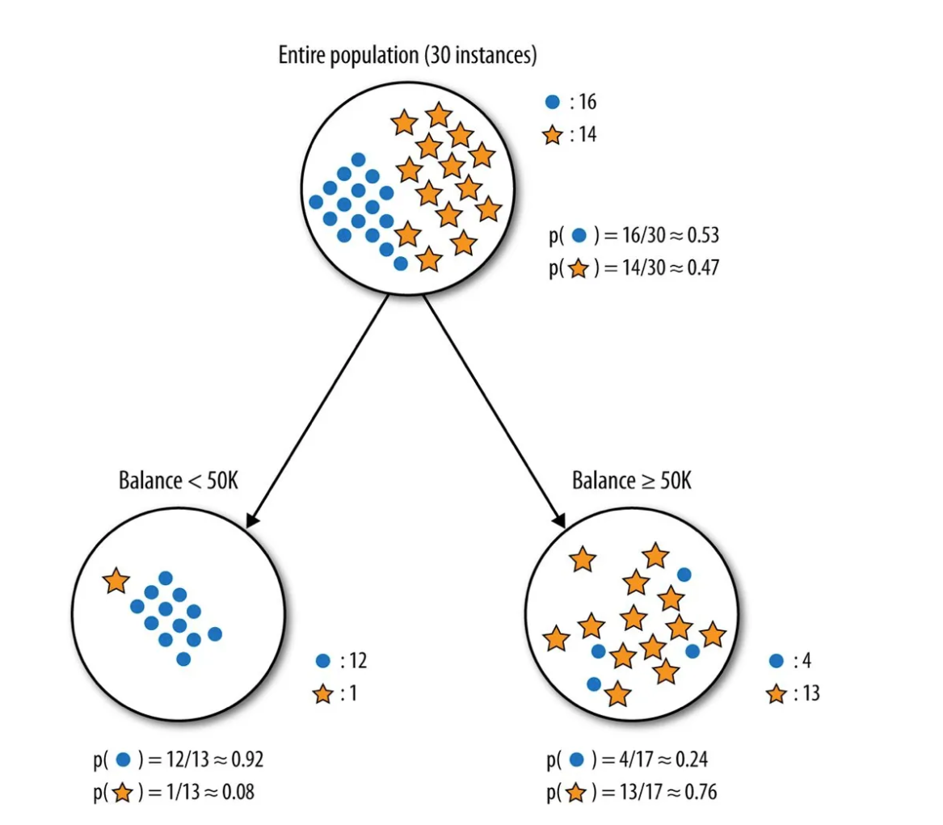
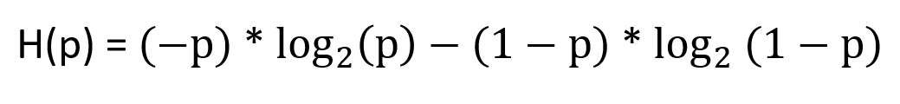
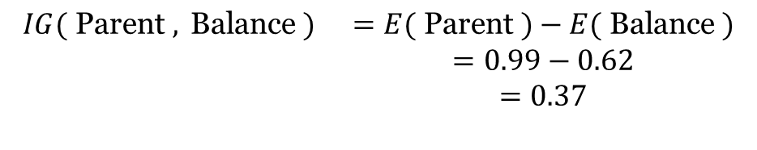
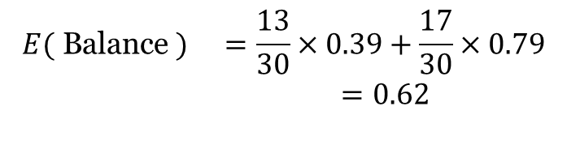
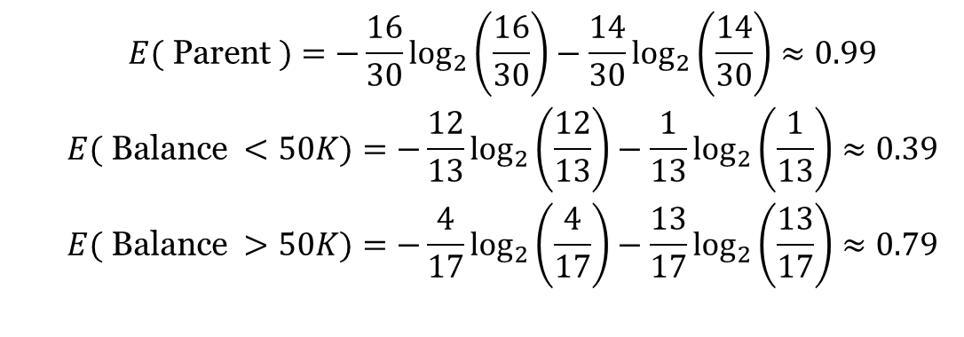
RECAP
$$\begin{matrix} & E( \text{Parent} )=−\frac{16}{30}\log_{2}⁡\left(\frac{16}{30}\right)−\frac{14}{30}\log_{2}⁡\left(\frac{14}{30}\right)≈0.99 \\ & E( \text{Balance} <50K)=−\frac{12}{13}\log_{2}⁡\left(\frac{12}{13}\right)−\frac{1}{13}\log_{2}⁡\left(\frac{1}{13}\right)≈0.39 \\ & E( \text{Balance} >50K)=−\frac{4}{17}\log_{2}⁡\left(\frac{4}{17}\right)−\frac{13}{17}\log_{2}⁡\left(\frac{13}{17}\right)≈0.79\end{matrix}$$
Weighted Average of entropy for each node:
$$\begin{matrix}E( \text{Balance} ) & =\frac{13}{30}×0.39+\frac{17}{30}×0.79 \\ & =0.62\end{matrix}$$
Information Gain:
$$\begin{matrix}IG( \text{Parent} , \text{Balance} ) & =E( \text{Parent} )−E( \text{Balance} ) \\ & =0.99−0.62 \\ & =0.37\end{matrix}$$

Slide 6
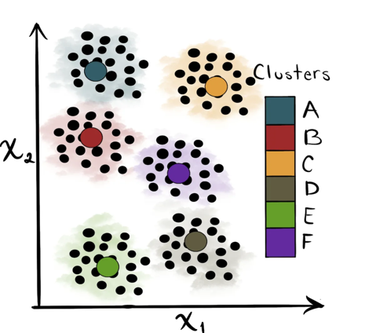
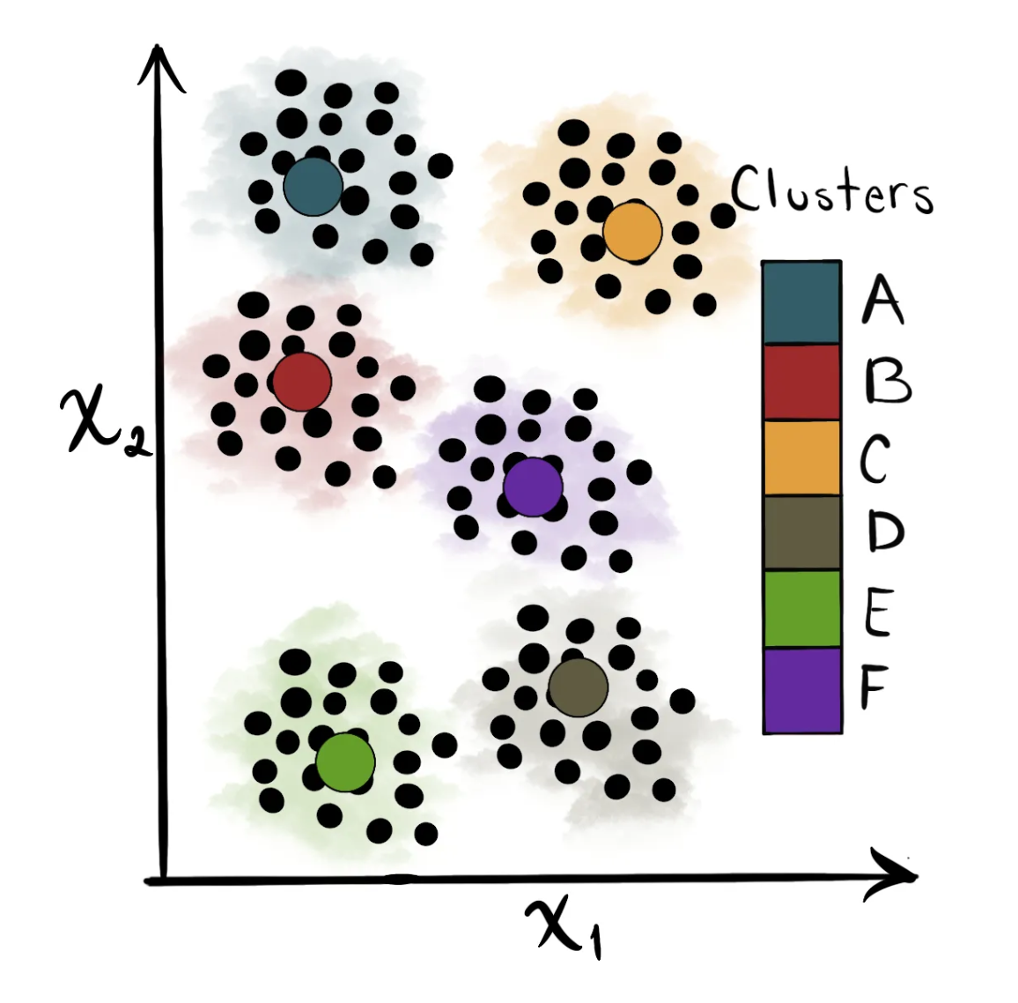
Clustering
Supervised Learning
Unsupervised Learning

Slide 7

Applications

Slide 8
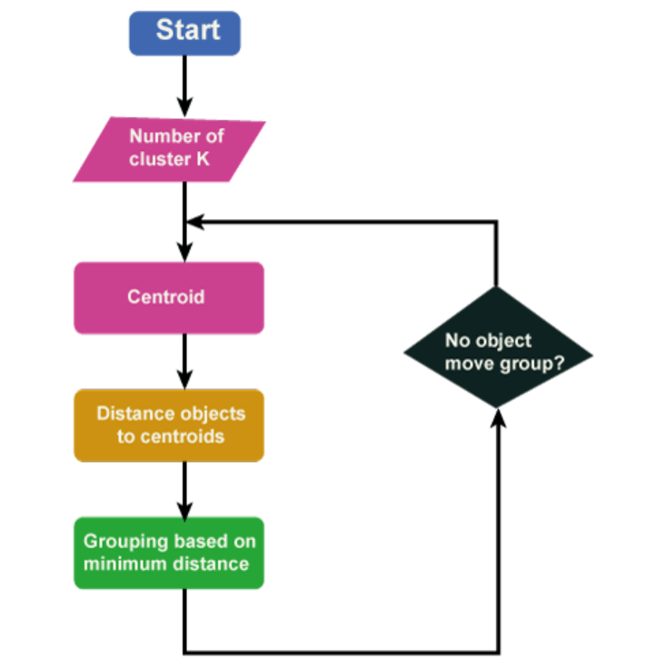
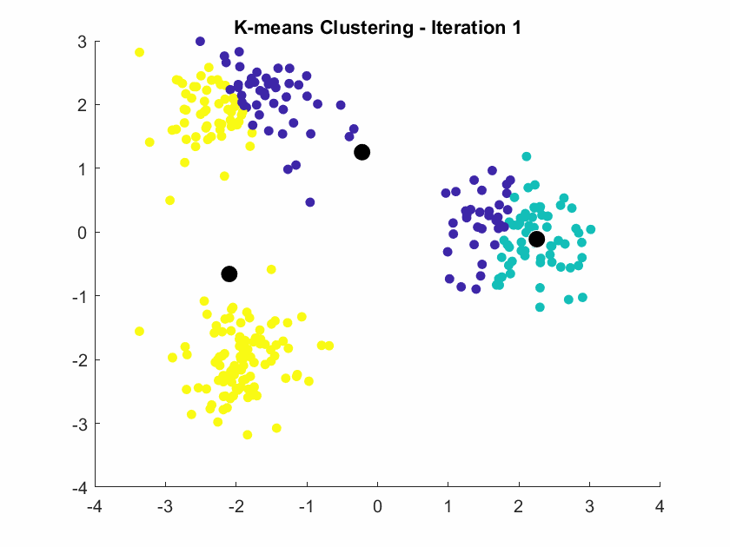
K-means Intuition

Slide 9
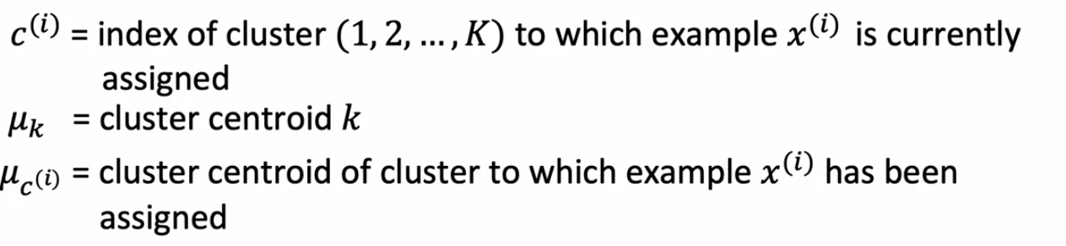
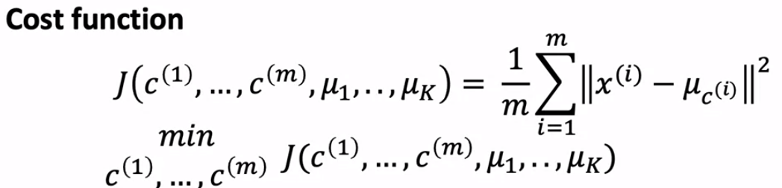
K Means Optimization Objective

Slide 10
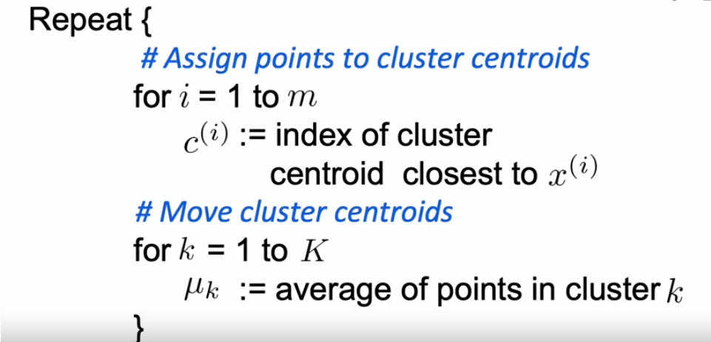

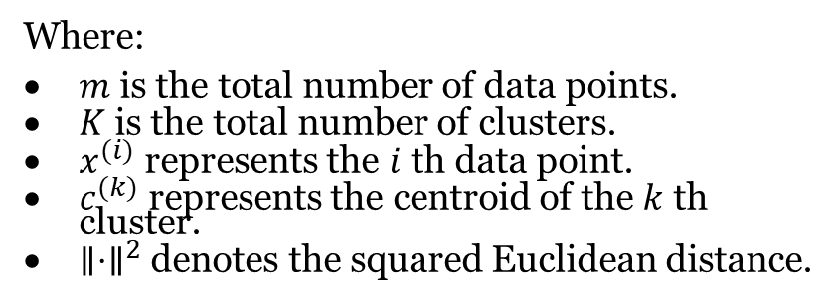
Cost Function for K Means
$$J=\sum_{i=1}^{m}{ }\sum_{k=1}^{K}{ }{\left.∥x^{\left(i\right)}−c^{\left(k\right)}∥\right.}^{2}$$
Where:
$m$ is the total number of data points.
$K$ is the total number of clusters.
$x^{(i)}$ represents the $i$ th data point.
$c^{(k)}$ represents the centroid of the $k$ th cluster.
$∥⋅∥^{2}$ denotes the squared Euclidean distance.

Slide 11
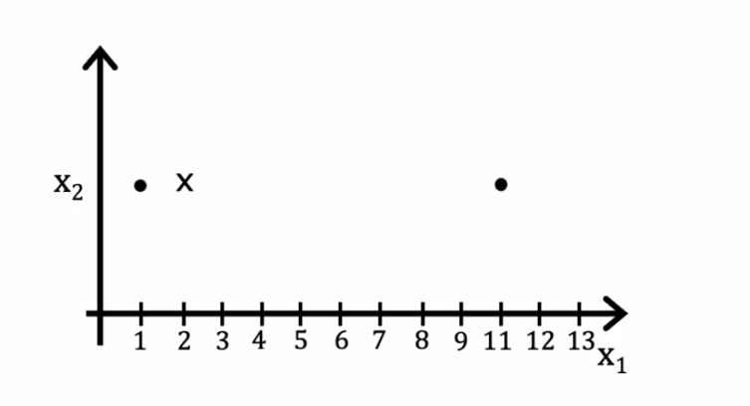



Moving the Centroid
$\frac{1}{2}\left(1^{2}+9^{2}\right)=\frac{1}{2}\left(1+81\right)=41$
$\frac{1}{2}\left(1+11\right)=6$
1
9
x
$$\frac{1}{2}\left(5^{2}+5^{2}\right)=25$$
5
5

Slide 12

How can you initiate your centroid location
Randomly

Slide 13
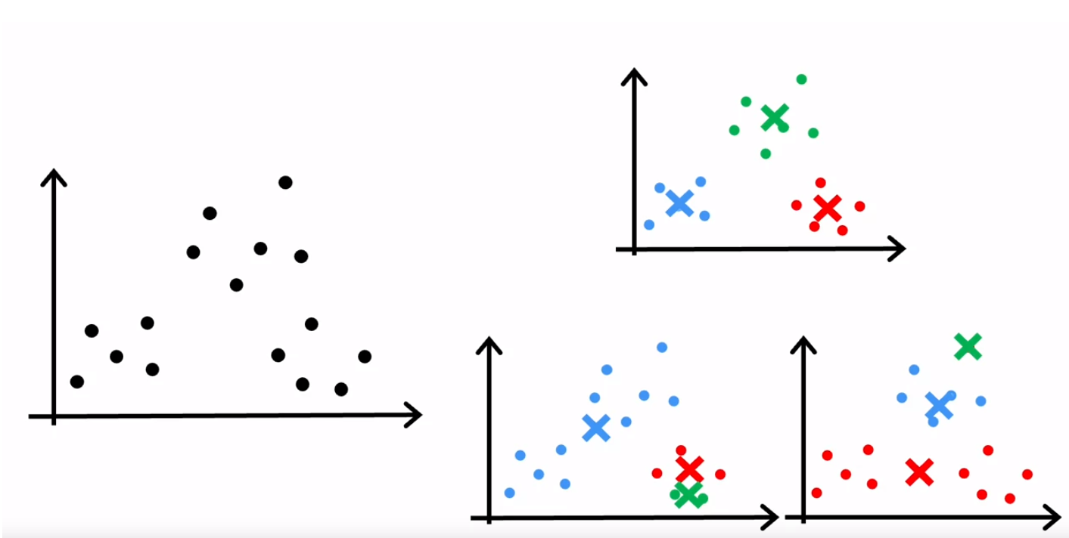
Random Initialization

Slide 14
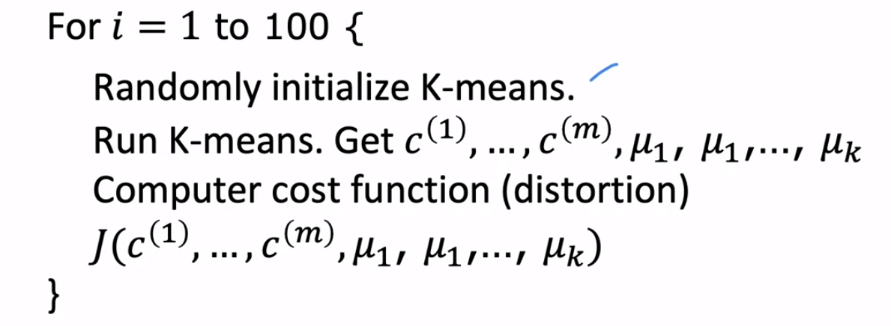
Random Initialization

Slide 15
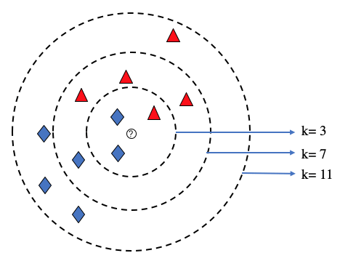
What is the Right Value of K?

Slide 16
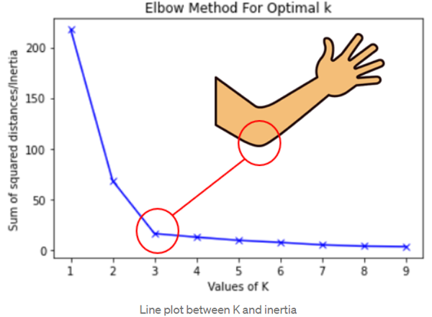
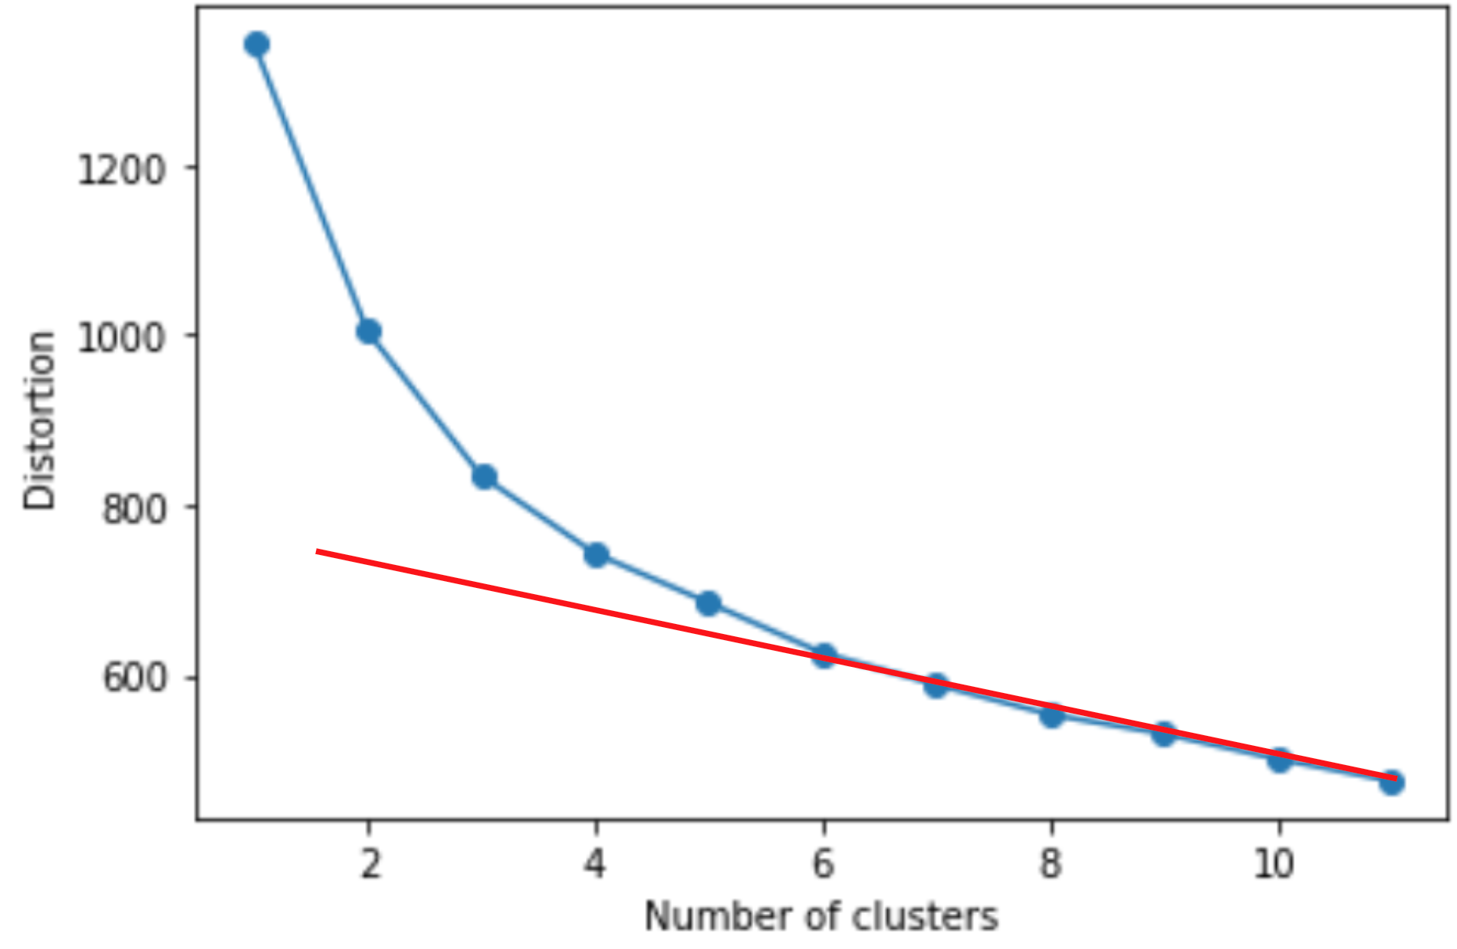
Elbow Method

Slide 17
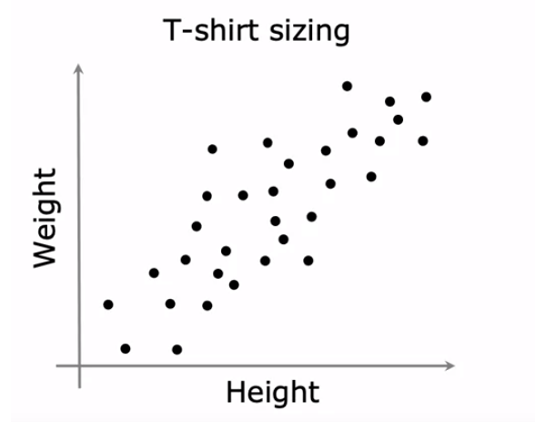
Example
L
XL
M
M
L
S
S
XS

Slide 18

Q&A

Slide 19
Quiz Question
When initializing K-means with random centroids, what is the potential drawback of using this method?
a) It always converges to the global optimum
b) It may result in poor local optima depending on the initial randomization
c) It guarantees a faster convergence rate
d) It reduces the number of clusters

Slide 20
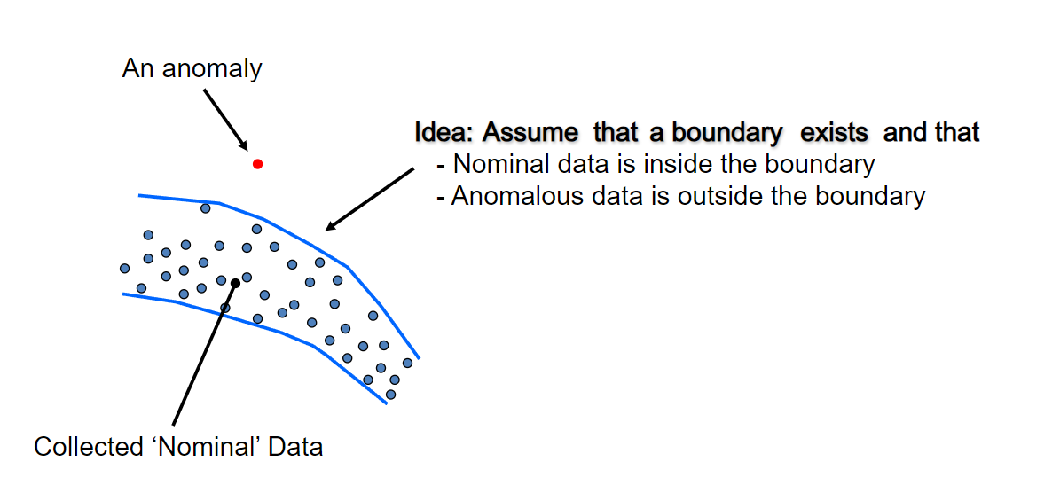
Anomaly Detection

Slide 21
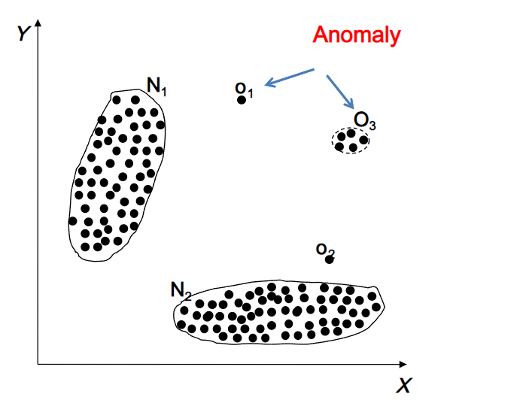
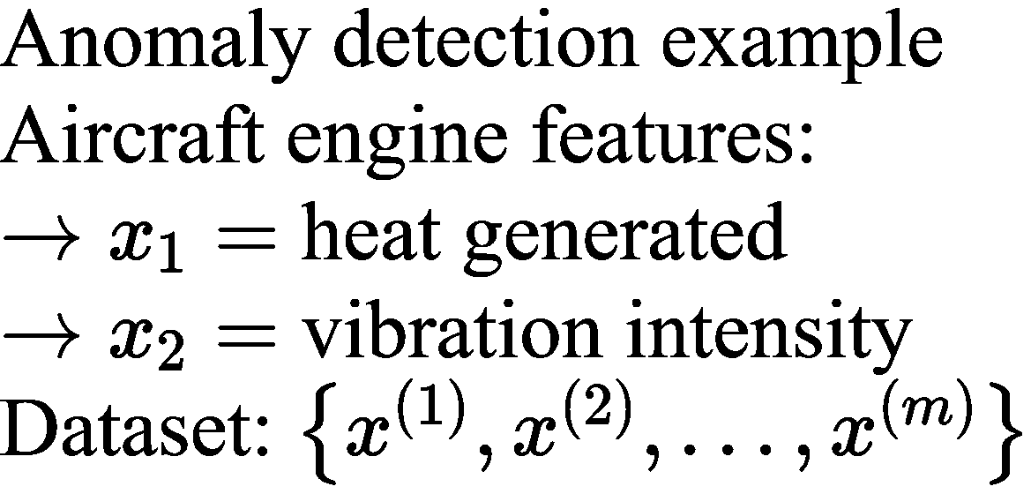
Anomaly Detection

Slide 22
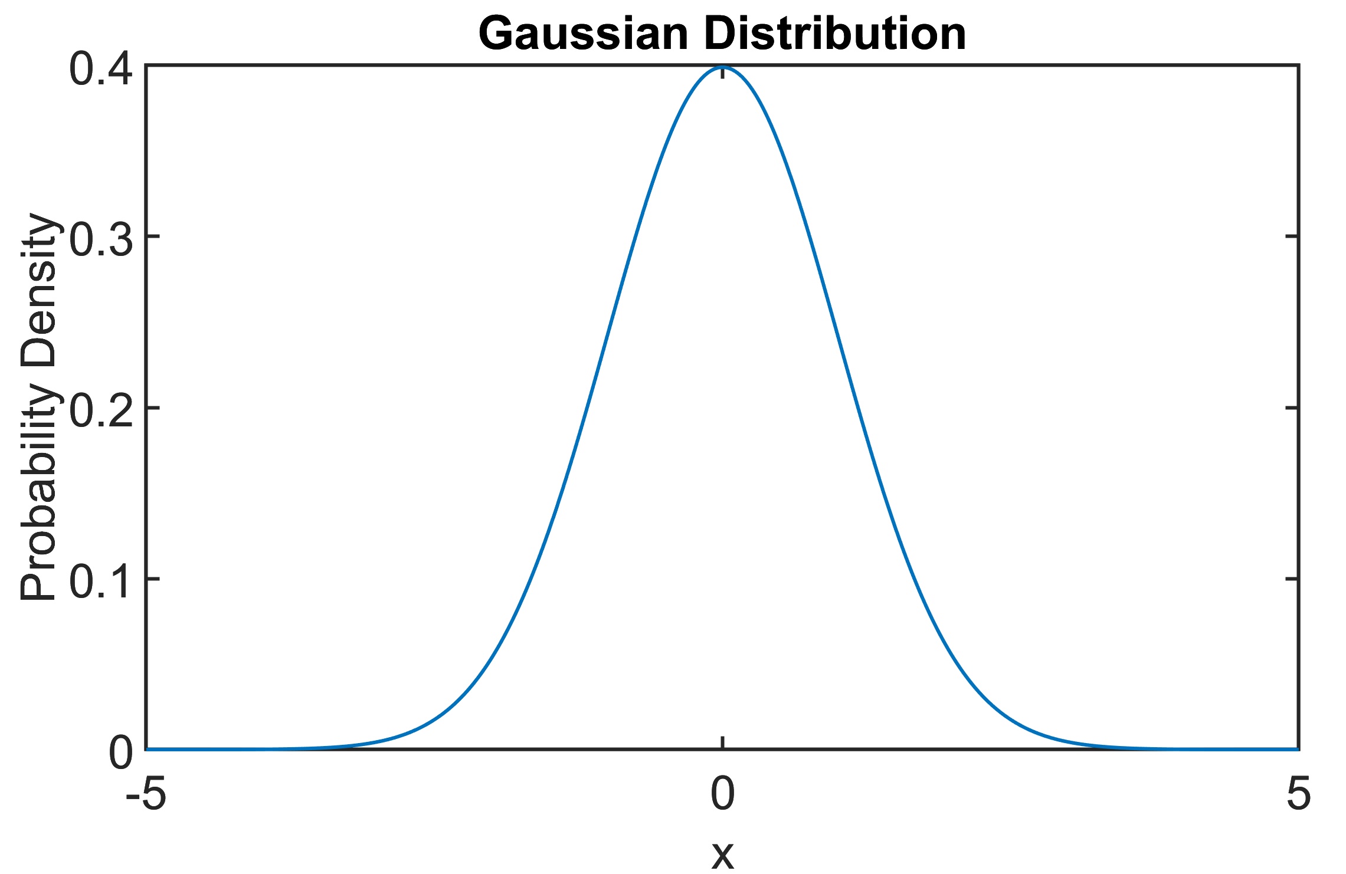



Gaussian Distribution
$$p\left(x\right)=\frac{1}{\sqrt{2π}σ}e^{\frac{−\left(x−\left(μ\right))^{2}\right.}{2}σ^{2}}$$
$$σ$$
$$μ$$

Slide 23
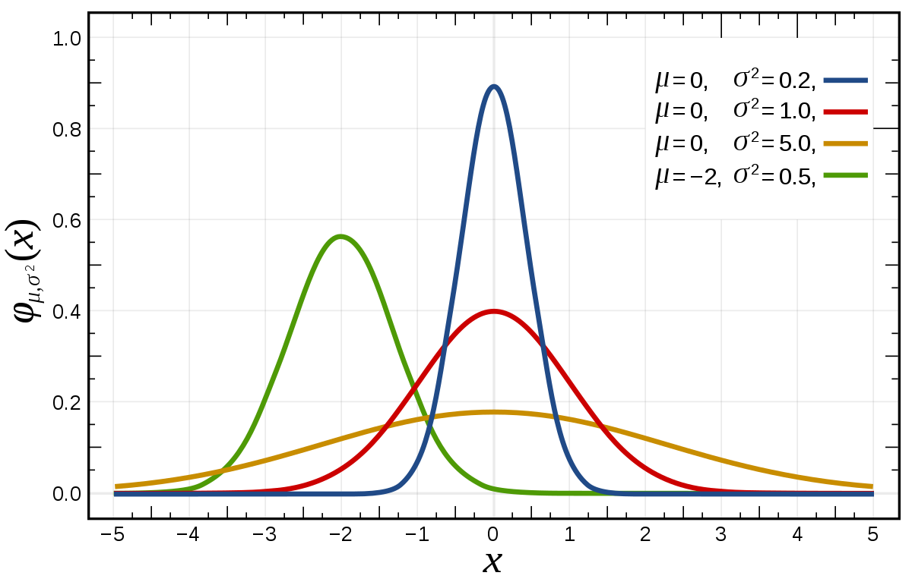
Different Gaussian Distribution

Slide 24
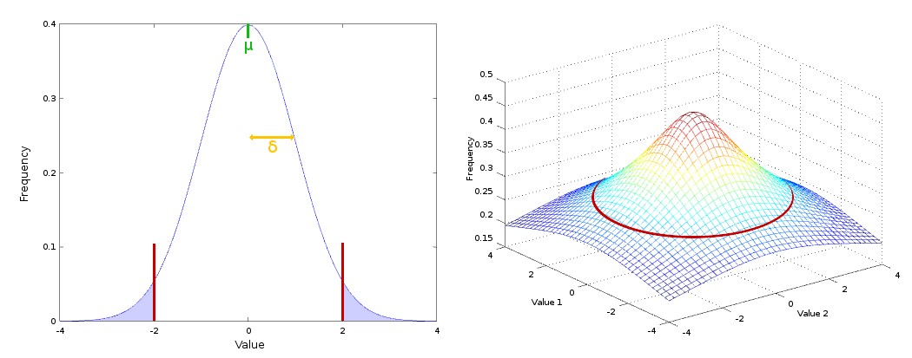
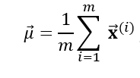

Parameter Estimation

Slide 25
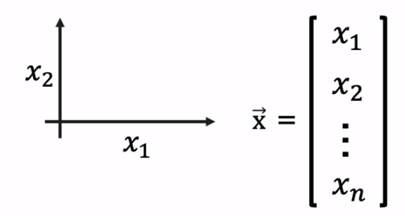
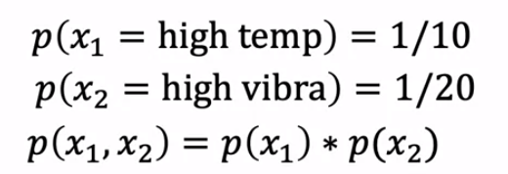

Density Estimation
Training set: $\left\{{\vec{x}}^{(1)},{\vec{x}}^{(2)},…,{\vec{x}}^{(m)}\right\}$
Each example ${\vec{x}}^{(i)}$ has $n$ features
$$p(\vec{x})=p\left(x_{1};μ_{1},σ_{λ}^{2}\right)∗p\left(x_{2};μ_{2},σ_{2}^{2}\right)∗p\left(x_{3};μ_{3},σ_{3}^{2}\right)∗⋯∗p\left(x_{n};μ_{n},σ_{n}^{2}\right)$$
$$=∏_{j=1}^{n} p\left(x_{j};μ_{j},σ_{j}^{2}\right)$$

Slide 26
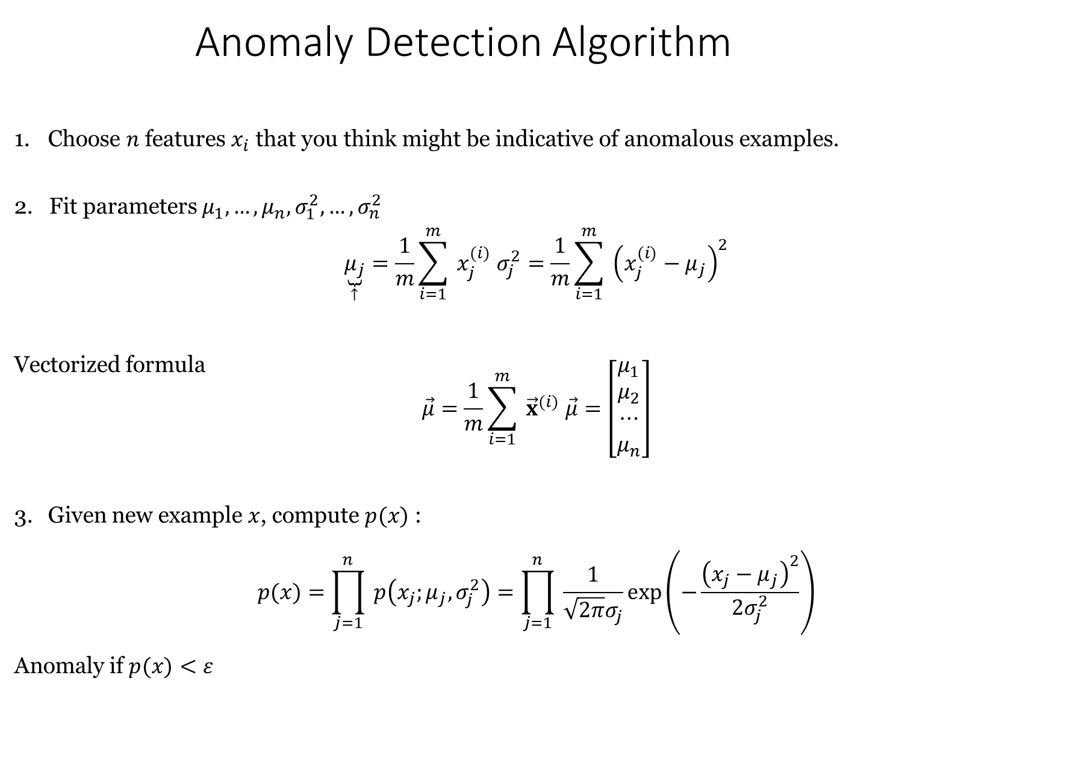
Anomaly Detection Algorithm
Choose $n$ features $x_{i}$ that you think might be indicative of anomalous examples.
2. Fit parameters $μ_{1},…,μ_{n},σ_{1}^{2},…,σ_{n}^{2}$
$$\underset{↑}{\underbrace{μ_{j}}}=\frac{1}{m}\sum_{i=1}^{m}{ }x_{j}^{(i)} σ_{j}^{2}=\frac{1}{m}\sum_{i=1}^{m}{ }{\left(x_{j}^{(i)}−μ_{j}\right)}^{2}$$
Vectorized formula
$$\vec{μ}=\frac{1}{m}\sum_{i=1}^{m}{ }{\vec{x}}^{(i)} \vec{μ}=\left[\begin{matrix}μ_{1} \\ μ_{2} \\ ⋯ \\ μ_{n}\end{matrix}\right]$$
Given new example $x$, compute $p(x)$ :
$$p(x)=\prod_{j=1}^{n}{ }p\left(x_{j};μ_{j},σ_{j}^{2}\right)=\prod_{j=1}^{n}{ }\frac{1}{\sqrt{2π}σ_{j}}exp⁡\left(−\frac{{\left(x_{j}−μ_{j}\right)}^{2}}{2σ_{j}^{2}}\right)$$
Anomaly if $p(x)<ε$

Slide 27
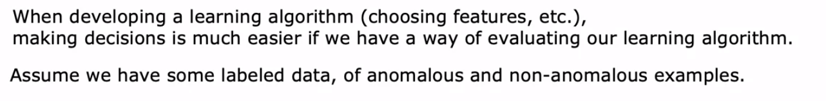
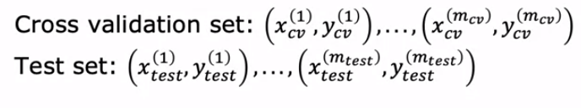
The Importance of Real-Number Evaluation

Slide 28

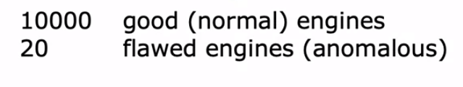
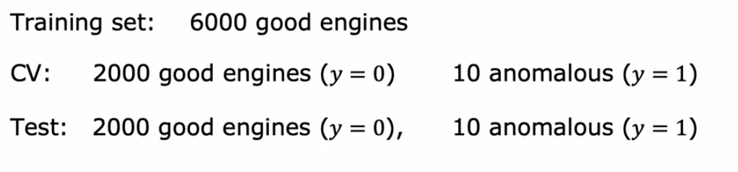
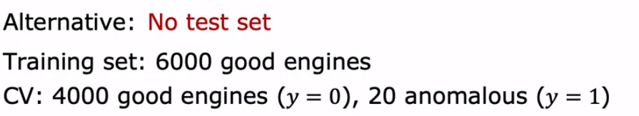
Aircraft Engines Monitoring Example

Slide 29
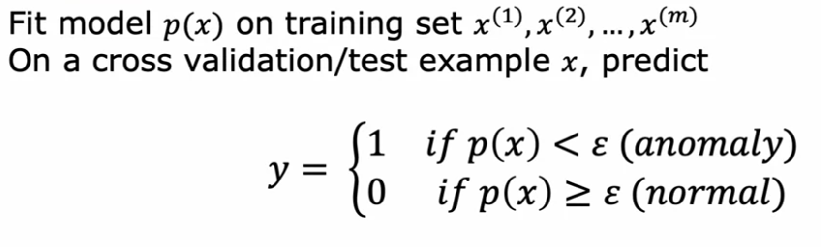
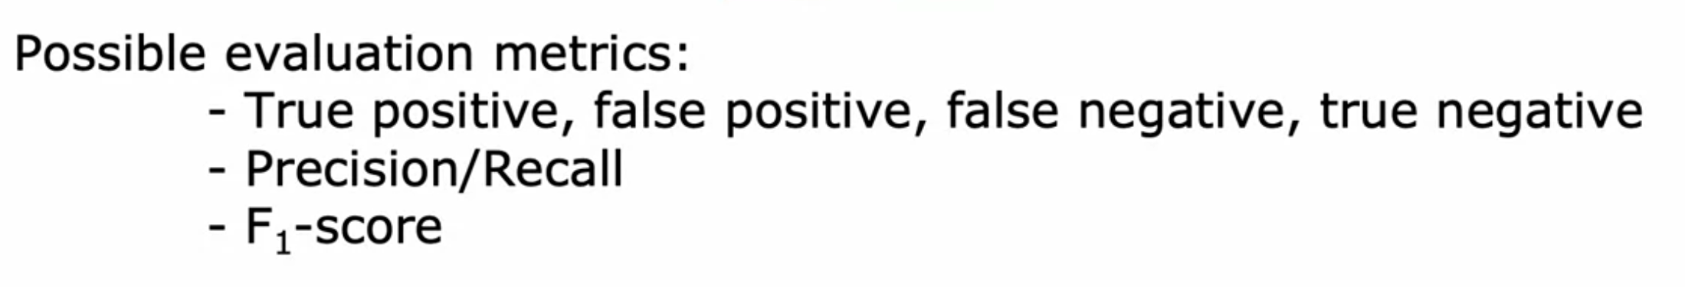
Algorithm Evaluation

Slide 30
Anomaly Detection
Supervised Learning
Very small number of positive examples (y = 1). (0-20 is common). Large number of negative (y = 0) examples.
Large number of positive and negative examples.
Many different ‘types’ of anomalies. Hard for any algorithm to learn from positibe examples what the anomalies look like; future anomalies may look nothing like any of the anomalous examples we have seen so far
Enough positive examples for algorithm to get a sense of what positive examples are like, future positive examples likely to be similar to ones in training set.

Slide 31
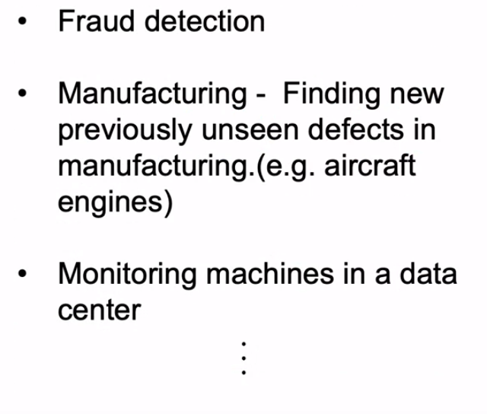
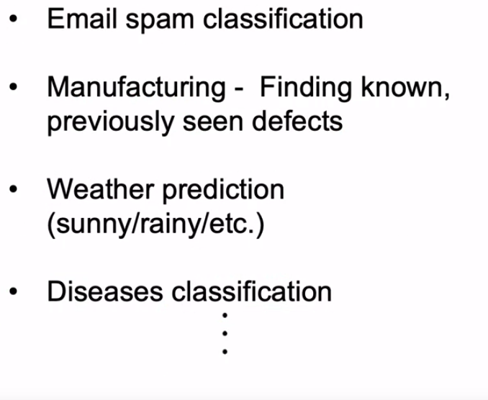
Anomaly Detection
Supervised Learning

Slide 32
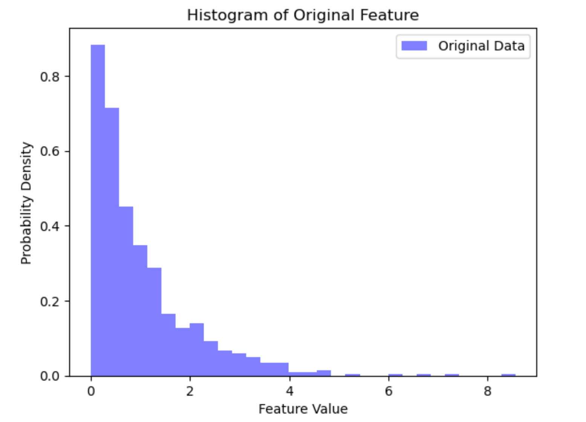
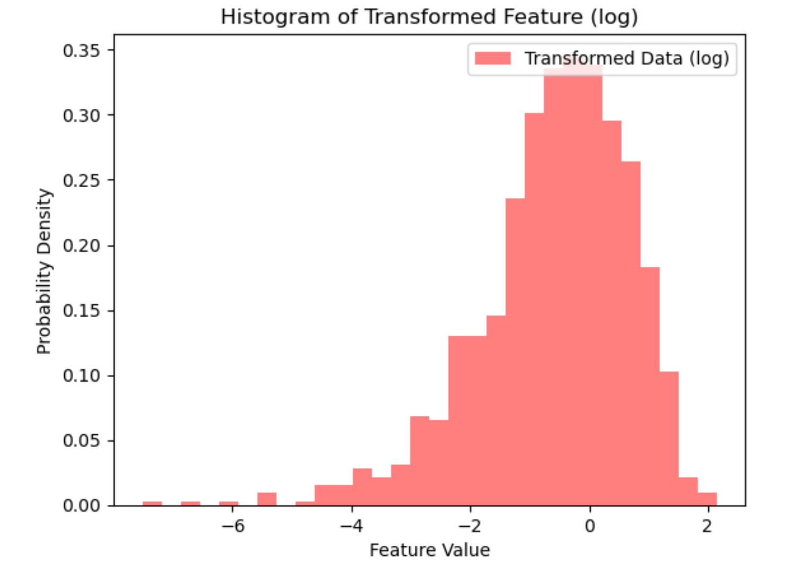
Non Gaussian Features

Slide 33


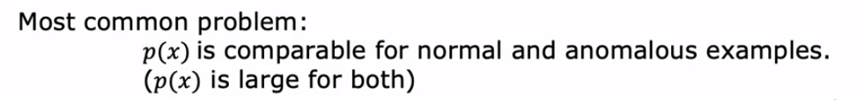
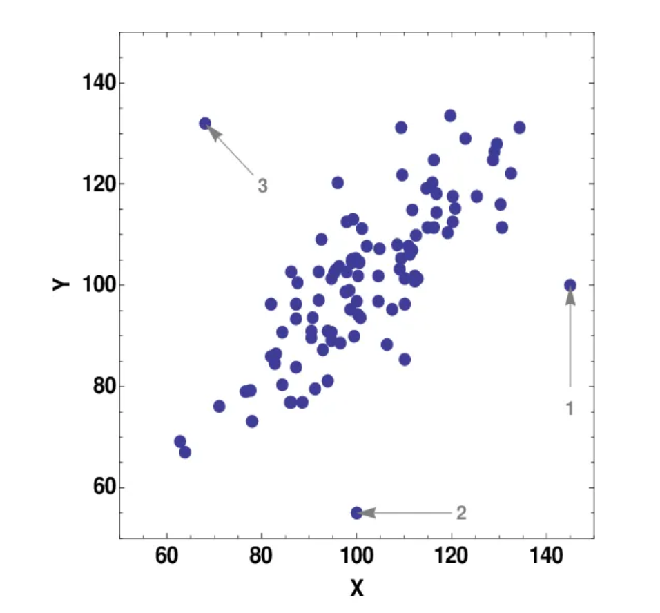
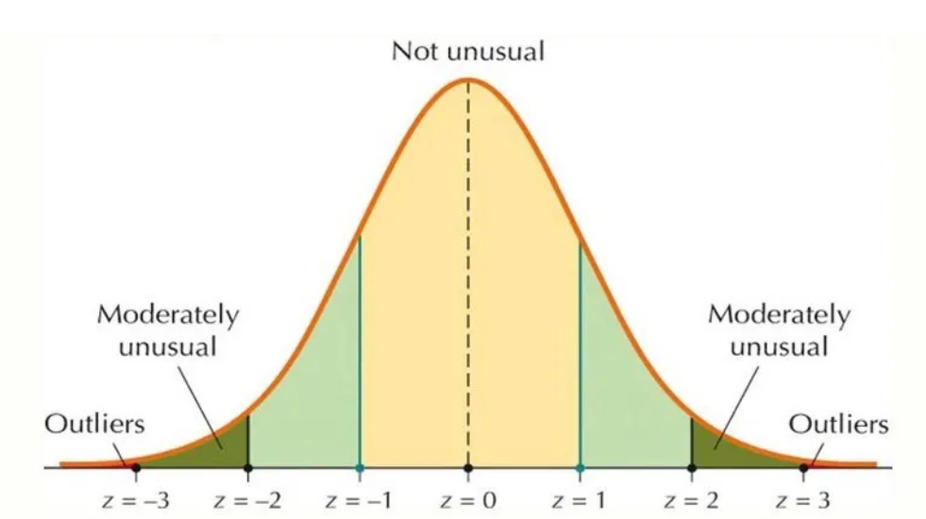
Error Analysis for Anomaly Detection

Slide 34
Q&A

Slide 35
Quiz Question
Which of the following is a common use case for anomaly detection?
A) Predicting stock market prices
B) Classifying images of cats and dogs
C) Detecting fraudulent credit card transactions
D) Recommending movies to users

